Slide 1
COMPUTERFORENSICS
A Presentation By
Justin Tecson

Slide 2
A crucial discovery
2008 - Police receive disturbing information about a Chicago woman who brought a 3 year old to a “sex party”
Both the 3-year-old and an 11-year-old girl were abused
The crime had been committed, but the police lacked evidence
Regional Computer Forensics Laboratory (RCFL)
Used sophisticated technology to recover what was thought to be deleted
“Map to the party” email uncovered; all suspects convicted to life sentences

Slide 3
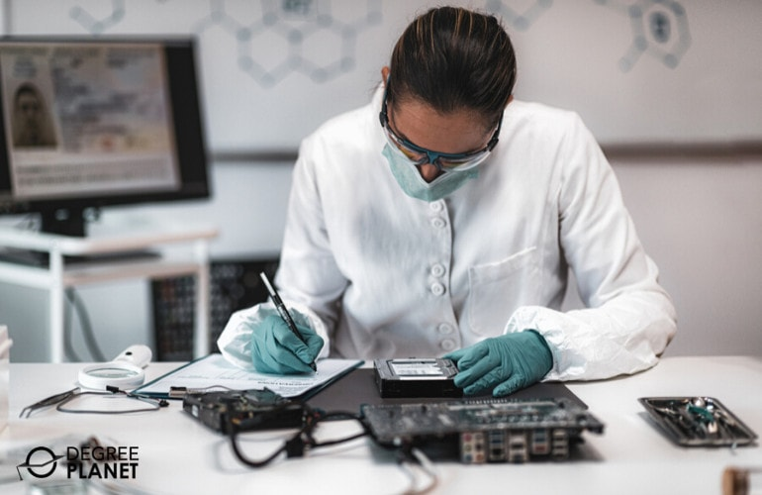
The profession and its purpose
Groups like the RCFL focus on Computer Forensics which mainly homes in on evidence retrieval
A job performed after the crime has been committed
Very different from the field of Cybersecurity
Helps to prevent future cybercrimes

Slide 4


The tools of the trade
Evidence retrieval is done with specialized software:
  The Sleuth Kit
  ProDiscover Forensic
These tools allow for:
  Data Recovery
  Disk Imaging
  Verifies File Integrity
  Generates Evidence Reports
Typically, these tools will be used on a copy of the evidence rather than the original

Slide 5
A procedure to follow
Computer Forensics is not without its restraints:
  Legal procedures must be taken
  Computer Investigations have to follow a chain of custody when handling evidence
  Law Enforcement must obtain a search warrant prior to evidence retrieval
Computer Forensic Examiners must then locate and gather the evidence, apply write blockers to the device as well as tamper seal it in evidence bags
A formal evidence report must also be written up after the fact

Slide 6
A hazardous environment
A Computer Forensic Examiner’s job is not without its risks…
Risks involved in the evidence retrieval process
  Suspects may booby trap incriminating machines/drives with software to erase data the moment a button is pressed
  Prevents the Examiner from proving data originated from the suspect’s machine
  Not protecting physical computer evidence in sealed bags or write blockers potentially renders it inadmissible in court
  Improvised explosive devices can also be rigged onto computer cases

Slide 7
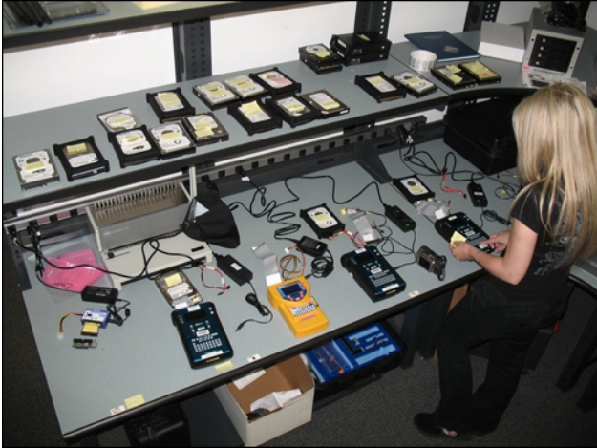
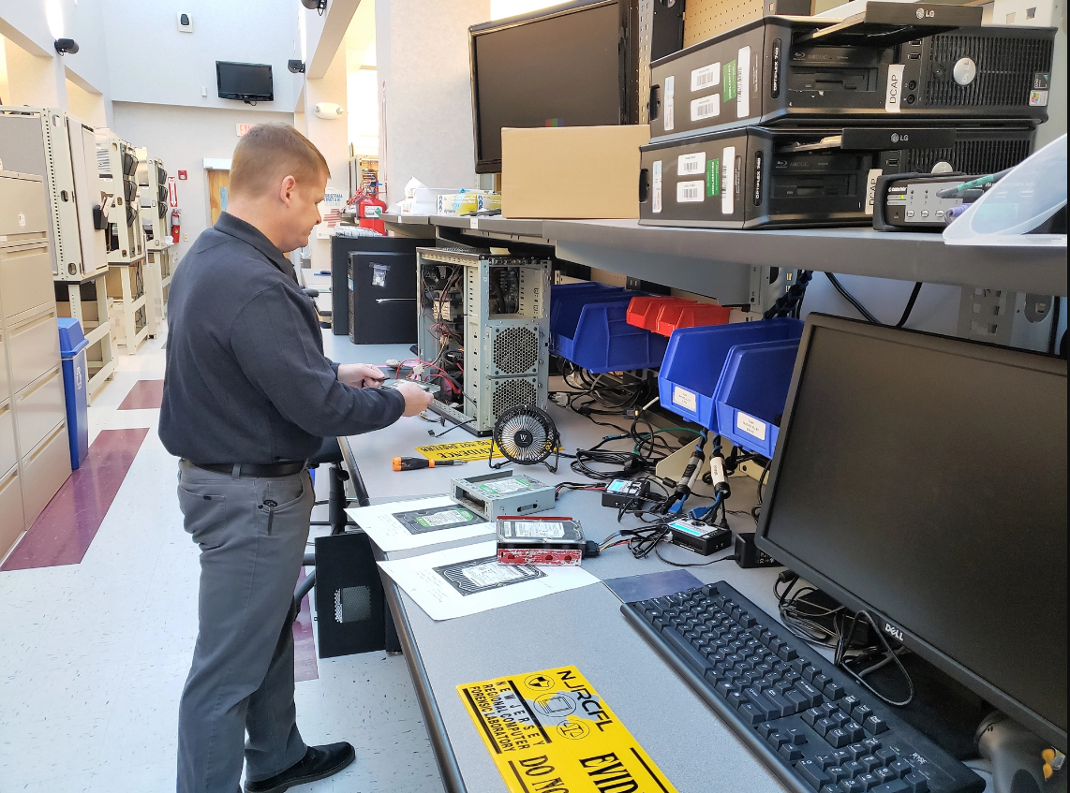

Wrap Up
In short, Computer Forensics is an important aspect of evidence recovery and the imprisonment of criminals
Without the technical knowledge of these specialists, regular Law Enforcement personnel would have a tough time in both criminal trials and obtaining incriminating digital evidence

Slide 8
Sources
https://www.rcfl.gov/
https://www.devry.edu/online-programs/area-of-study/technology/what-is-computer-forensics.html
https://www.devry.edu/online-programs/area-of-study/cyber-security/computer-forensics-vs-cybersecurity.html#:~:text=Computer%20forensics%20deals%20with%20locating,while%20cyber%20security%20is%20preventative.
https://www.jurispro.com/files/articles/Pelton-Destroyed.pdf
https://www.fbi.gov/news/stories/digital-forensics

